Slide 1
Project Management & Metrics
Ms. Gagandeep Kaur
Assistant Professor
Department of Computer Science and Engineering
Chitkara University, Punjab

Slide 2
Management Spectrum
In software engineering, the management spectrum describes the management of a software project.
The management of a software project starts from requirement analysis and finishes based on the nature of the product; it may or may not end because almost all software products face changes and require support.
The management spectrum focuses on the four P’s:
People 3. Process
2. Product 4. Project
Here, the manager of the project has to control all these P’s to have a smooth flow in the progress of the project and to reach the goal.

Slide 3
First P - People
The “people factor” is so important that the Software Engineering Institute has developed a People Capability Maturity Model (People-CMM), in recognition of the fact that
“Every organization needs to continually improve its ability to attract, develop, motivate, organize, and retain the workforce needed to accomplish its strategic business objectives.”
Organizations that achieve high levels of People-CMM maturity have a higher likelihood of implementing effective software project management practices.

Slide 4
First P - People
Depending on their roles and responsibilities, people involved in a software project can be categorized into the following main categories or stakeholders:
Senior manager
Project manager
Software Engineer
Customer
End user

Slide 5
People - Stakeholders
Senior managers who define the business issues that often have significant influence on the project.
Project (technical) managers who must plan, motivate, organize, and control the practitioners who do software work.
Practitioners/Software Engineers who deliver the technical skills that are necessary to engineer a product or application.
Customers who specify the requirements for the software to be engineered and other stakeholders who have a peripheral interest in the outcome.
End-users who interact with the software once it is released for production use.

Slide 6
People – Team Leaders
The MOI model of leadership
Motivation - The ability to encourage (by “push or pull”) technical people to produce to their best ability.
Organization - The ability to mold existing processes (or invent new ones) that will enable the initial concept to be translated into a final product.
Ideas or innovation - The ability to encourage people to create and feel creative when they work within bounds established for a particular software product or application.

Slide 7
People – Software Team
Seven project factors that should be considered when planning the structure of software engineering teams:
Difficulty of the problem to be solved
“Size” of the resultant program(s) in lines of code or function points
Time that the team will stay together (team lifetime)
Degree to which the problem can be modularized
Required quality and reliability of the system to be built
Rigidity of the delivery date
Degree of sociability (communication) required for the project

Slide 8
Second P - Product
Customers and software developers must meet:
To define objectives and scope of the project.
To consider alternative solutions and to select the best possible approach.
To identify technical and management constraints.
Objectives identify the overall goals for the product (from the customers’ point of view) without considering how these goals will be achieved.
Scope identifies the primary data, functions and behaviors that characterize the product, and more important, attempts to bound these characteristics in a quantitative manner.
If scope and objectives are not defined, then it will be impossible:
To define a reasonable and accurate estimate of cost.
To assess possible risks and to define a manageable project schedule.

Slide 9
Product/Software Scope
The first software project management activity is the determination of software scope.
Scope is defined by answering the following questions:
Context: How does the software to be built fit into a larger system, product, or business context and what constraints are imposed as a result of the context?
Information objectives: What customer-visible data objects are produced as output from the software? What data objects are required for input?
Function and performance: What function does the software perform to transform input data into output? Are any special performance characteristics to be addressed?

Slide 10
Problem Decomposition
Sometimes called partitioning or problem elaboration.
Once scope is defined …
It is decomposed into constituent functions
It is decomposed into user-visible data objects
or
It is decomposed into a set of problem classes
Decomposition process continues until all functions or problem classes have been defined

Slide 11
Third P - Process
The project manager must decide which process model is appropriate for:
The customers who have requested the product and the people who will do the work
The characteristics of the product itself
The project environment in which the software team works.
When a process model has been selected, define a preliminary project plan on the set of common process framework activities.

Slide 12
Third P – Process (contd.)
Once a process framework has been established
Consider project characteristics
Determine the degree of rigor required
Define a task set for each software engineering activity
Task set :
Software engineering tasks
Work products
Quality assurance points
Milestones

Slide 13
Fourth P - Project
For a successful project, we must understand what can go wrong
Projects get into trouble when …
Software people don’t understand their customer’s needs.
The product scope is poorly defined.
Changes are managed poorly.
The chosen technology changes.
Business needs change [or are ill-defined].
Deadlines are unrealistic and Users are resistant.
Sponsorship is lost [or was never properly obtained].
The project team lacks people with appropriate skills.
Managers [and practitioners] avoid best practices and lessons learned.
Manager acts to avoid these problems by using five-part commonsense approach to software projects

Slide 14
Common Sense Approaches to Projects
Start on the right foot: This is accomplished by working hard (very hard) to understand the problem that is to be solved and then setting realistic objectives and expectations.
Maintain momentum: The project manager must provide incentives to keep turnover of personnel to an absolute minimum, the team should emphasize quality in every task it performs, and senior management should do everything possible to stay out of the team’s way.

Slide 15
Common Sense Approaches to Projects
Track progress: For a software project, progress is tracked as work products (e.g., models, source code, sets of test cases) are produced and approved (using formal technical reviews) as part of a quality assurance activity.
Make smart decisions: In essence, the decisions of the project manager and the software team should be to “keep it simple.”
Conduct a postmortem analysis: Establish a consistent mechanism for extracting lessons learned for each project.

Slide 16
Metrics in Process and Project Domains

Slide 17
Introduction
Process metrics are collected across all projects and over long periods of time. Their intent is to provide a set of process indicators that lead to long-term software process improvement.
Project metrics enable a software project manager to:
(1) assess the status of an ongoing project,
(2) track potential risks,
(3) uncover problem areas before they go “critical,”
(4) adjust work flow or tasks, and
(5) evaluate the project team’s ability to control quality of software work products.

Slide 18
Process Metrics and Software Process Improvement
The only rational way to improve any process is to
measure specific attributes of the process,
develop a set of meaningful metrics based on these attributes, and
then use the metrics to provide indicators that will lead to a strategy for improvement.
Process is only one of a number of “controllable factors” in improving software quality and organizational performance.

Slide 19
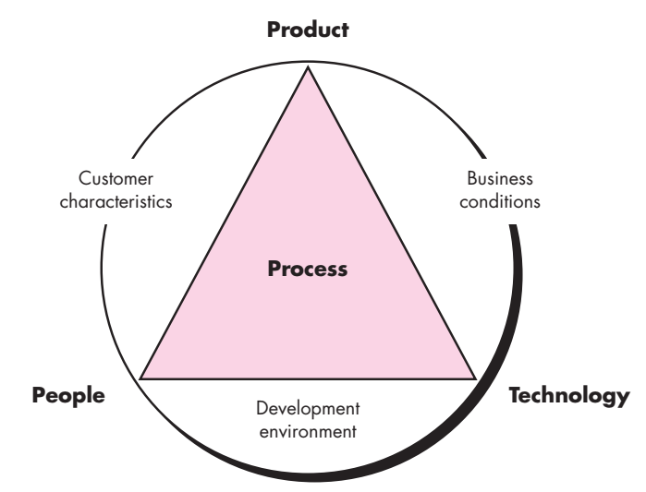
Process Metrics and Software Process Improvement (contd.)
Figure1: Determinants for software quality and organizational effectiveness.

Slide 20
Process Metrics and Software Process Improvement (contd.)
Process sits at the center of a triangle connecting three factors that have a profound influence on organizational performance and software quality.
In addition, the process triangle exists within a circle of environmental conditions that include the:
development environment (e.g., integrated software tools),
business conditions (e.g., deadlines, business rules), and
customer characteristics (e.g., ease of communication and collaboration)

Slide 21
Process Metrics and Software Process Improvement (contd.)
Process metrics can be either Public or Private.
Examples of private metrics include
defect rates (by individual),
defect rates (by component), and
errors found during development
Public metrics generally assimilate information that originally was private to individuals and teams.
Project-level defect rates (absolutely not attributed to an individual), effort, calendar times, and related data are collected and evaluated in an attempt to uncover indicators that can improve organizational process performance.

Slide 22
Process Metrics and Software Process Improvement (contd.)
Some process metrics are private to the software project team but public to all team members.
Examples include:
defects reported for major software functions (that have been developed by a number of practitioners),
errors found during technical reviews, and
lines of code or function points per component or function.
Software process metrics can provide significant benefit as an organization works to improve its overall level of process maturity. However, like all metrics, these can be misused, creating more problems than they solve. Hence, “Software Metrics Etiquette” are suggested.

Slide 23
Process Metrics and Software Process Improvement (contd.)
“Software Metrics Etiquette” that is appropriate for both managers and practitioners as they institute a process metrics program:
Use common sense and organizational sensitivity when interpreting metrics data.
Provide regular feedback to the individuals and teams who collect measures and metrics.
Don’t use metrics to appraise individuals.
Work with practitioners and teams to set clear goals and metrics that will be used to achieve them.
Never use metrics to threaten individuals or teams.
Metrics data that indicate a problem area should not be considered “negative.” These data are merely an indicator for process improvement.
Don’t obsess on a single metric to the exclusion of other important metrics.

Slide 24
Project Metrics
Project metrics and the indicators derived from them are used by a project manager and a software team to adapt project workflow and technical activities.
The first application of project metrics on most software projects occurs during estimation.
Metrics collected from past projects are used as a basis from which effort and time estimates are made for current software work.
As a project proceeds, measures of effort and calendar time expended are compared to original estimates (and the project schedule).
The project manager uses this data to monitor and control progress.

Slide 25
Project Metrics (contd.)
As technical work commences, other project metrics begin to have significance.
Production rates represented in terms of models created, review hours, function points, and delivered source lines are measured.
In addition, errors uncovered during each software engineering task are tracked.
As the software evolves from requirements into design, technical metrics are collected to assess design quality and to provide indicators that will influence the approach taken to code generation and testing.

Slide 26
Project Metrices (contd.)
The intent of project metrics is twofold.
First, these metrics are used to minimize the development schedule by making the adjustments necessary to avoid delays and mitigate potential problems and risks.
Second, project metrics are used to assess product quality on an ongoing basis and, when necessary, modify the technical approach to improve quality.
As quality improves, defects are minimized, and as the defect count goes down, the amount of rework required during the project is also reduced.
This leads to a reduction in overall project cost.

Slide 27
Metrics for Software Quality

Slide 28
Measures of Software Quality
Correctness:
Is the degree to which the software performs its required function.
The most common measure for correctness is defects per KLOC (thousand line of codes), where a defect is defined as a verified lack of conformance to requirements.
When considering the overall quality of a software product, defects are those problems reported by a user of the program after the program has been released for general use.
For quality assessment purposes, defects are counted over a standard period of time, typically one year.

Slide 29
Measures of Software Quality
Maintainability: It is the ease with which a program can be
Corrected, if an error is encountered
Adapted, if the environment changes, or
Enhanced, if the customer desires changes in requirements.
There is no way to measure maintainability directly; therefore, you must use indirect measures.
A simple time-oriented metric is mean-time-to-change (MTTC), the time it takes to analyze the change request, design an appropriate modification, implement the change, test it, and distribute the change to all users. On average, programs that are maintainable will have a lower MTTC.

Slide 30
Measures of Software Quality
Integrity:
This attribute measures a system’s ability to withstand attacks (both accidental and intentional) to its security.
Attacks can be made on all three components of software: programs, data, and documentation.
To measure integrity, two additional attributes must be defined: threat and security.
Threat is the probability that an attack of a specific type will occur within a given time.
Security is the probability that the attack of a specific type will be repelled.

Slide 31
Measures of Software Quality
Integrity (contd.):
The integrity of a system can then be defined as:
For example, if threat (the probability that an attack will occur) is 0.25 and security (the likelihood of repelling an attack) is 0.95, the integrity of the system is 0.9875 (very high).
If, on the other hand, the threat probability is 0.50 and the likelihood of repelling an attack is only 0.25, the integrity of the system is 0.625 (unacceptably low).

Slide 32
Measures of Software Quality
Usability
If a program is not easy to use, it is often doomed to failure, even if the functions that it performs are valuable.
Usability is an attempt to quantify “user friendliness”.

Slide 33

Defect Removal Efficiency
A quality metric that provides benefit at both the project and process level is defect removal efficiency (DRE).
In essence, DRE is a measure of the filtering ability of quality assurance and control actions as they are applied throughout all process framework activities.
When considered for a project as a whole, DRE is defined in the following manner:
Here, E is the number of errors found before delivery of the software to the end user and D is the number of defects found after delivery.
As D increases, DRE decreases (i.e., becomes a smaller and smaller fraction)
The ideal value of DRE is 1, which means no defects are found after delivery.

Slide 34
Product Metrics

Slide 35
Measures, Metrics and Indicators
A measure provides a quantitative indication of the extent, amount, dimension, capacity, or size of some attribute of a product or process.
IEEE defines metric as “a quantitative measure of the degree to which a system, component, or process possesses a given attribute.”
An indicator is a metric or combination of metrics that provide insight into the software process, a software project, or the product itself.
An indicator provides insight that enables the project manager or software engineers to adjust the process, the project, or the product to make things better.

Slide 36
Measurement Process
A measurement process can be characterized by five activities:
Formulation. The derivation of software measures and metrics appropriate for the representation of the software that is being considered.
Collection. The mechanism used to accumulate data required to derive the formulated metrics.
Analysis. The computation of metrics and the application of mathematical tools.
Interpretation. The evaluation of metrics results in an effort to gain insight into the quality of the representation.
Feedback. Recommendations derived from the interpretation of product metrics transmitted to the software team.

Slide 37
Measurement Principles
The objectives of measurement should be established before data collection begins.
Each technical metric should be defined in an unambiguous manner.
Metrics should be derived based on a theory that is valid for the domain of application (e.g., metrics for design should draw upon basic design concepts and principles and attempt to provide an indication of the presence of an attribute that is deemed desirable).
Metrics should be tailored to best accommodate specific products and processes.

Slide 38
Goal Oriented Software Measurement
The Goal/Question/Metric (GQM) Paradigm has been developed as a technique for identifying meaningful metrics for any part of the software process.
GQM emphasizes the need to:
(1) establish an explicit measurement goal that is specific to the process activity or product characteristic that is to be assessed
(2) define a set of questions that must be answered in order to achieve the goal, and
(3) identify well-formulated metrics that help to answer these questions.

Slide 39
Goal Oriented Software Measurement
Goal definition template can be used to define each measurement goal. The template takes the form:
Analyze {the name of activity or attribute to be measured} for the purpose of {the overall objective of the analysis} with respect to {the aspect of the activity or attribute that is considered} from the viewpoint of {the people who have an interest in the measurement}in the context of {the environment in which the measurement takes place}.

Slide 40
Attributes of Effective Software Metrics
A set of attributes that should be encompassed by effective software metrics:
Simple and computable. It should be relatively easy to learn how to derive the metric, and its computation should not demand inordinate effort or time
Empirically and intuitively persuasive. The metric should satisfy the engineer’s intuitive notions about the product attribute under consideration
Consistent and objective. The metric should always yield results that are unambiguous.

Slide 41
Attributes of Effective Software Metrics
Consistent in its use of units and dimensions. The mathematical computation of the metric should use measures that do not lead to bizarre combinations of unit.
Programming language independent. Metrics should be based on the analysis model, the design model, or the structure of the program itself.
Effective mechanism for quality feedback. That is, the metric should provide a software engineer with information that can lead to a higher quality end product

Slide 42
Metrics for Requirement Model
Technical work in software engineering begins with the creation of the requirements model.
It is at this stage that requirements are derived and a foundation for design is established.
Therefore, product metrics that provide insight into the quality of the analysis model are desirable.

Slide 43
Metrics for Requirement Model – Function Point (FP) Metrics
The function point (FP) metric can be used effectively as a means for measuring the functionality delivered by a system.
The FP metric can then be used to
estimate the cost or effort required to design, code, and test the software;
predict the number of errors that will be encountered during testing; and
forecast the number of components and/or the number of projected source lines in the implemented system.
Function points are derived using an empirical relationship based on countable (direct) measures of software’s information domain value and qualitative assessments of software complexity.

Slide 44
Metrics for Requirement Model – Function Point (FP) Metrics
Information domain values are defined in the following manner:
Number of external inputs (EIs). Each external input originates from a user or is transmitted from another application and provides distinct application-oriented data or control information. Inputs are often used to update internal logical files (ILFs). Inputs should be distinguished from inquiries, which are counted separately.
Number of external outputs (EOs). Each external output is derived data within the application that provides information to the user. In this context external output refers to reports, screens, error messages, etc.

Slide 45
Metrics for Requirement Model – Function Point (FP) Metrics
Number of external inquiries (EQs). An external inquiry is defined as an online input that results in the generation of some immediate software response in the form of an online output (often retrieved from an ILF).
Number of internal logical files (ILFs). Each internal logical file is a logical grouping of data that resides within the application’s boundary and is maintained via external inputs.
Number of external interface files (EIFs). Each external interface file is a logical grouping of data that resides external to the application but provides information that may be of use to the application.

Slide 46
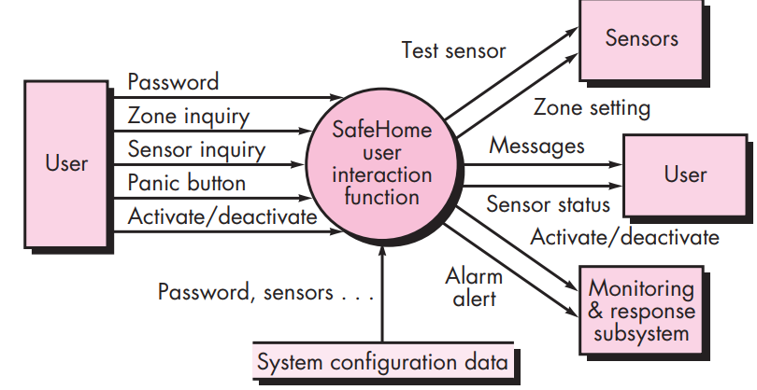
Metrics for Requirement Model – Function Point (FP) Metrics
Figure 2: SafeHome software data flow model example
Three external inputs (EIs) - password, panic button, and activate/deactivate
Two external inquiries (EQs) - zone inquiry and sensor inquiry.
One internal logical file (ILF) - system configuration file.
Two external outputs (EOs) - messages and sensor status.
Four external interface files (EIFs) - test sensor, zone setting, activate/deactivate, and alarm alert.

Slide 47
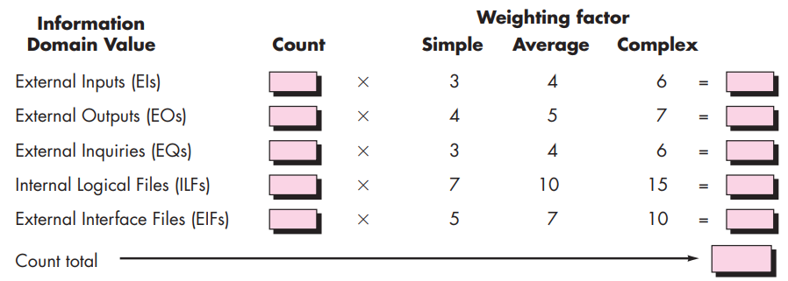
Metrics for Requirement Model – Function Point (FP) Metrics
Figure 3: Computing function points
To compute function points (FP), the following relationship is used:
Where count total is the sum of all FP entries obtained from the above table.

Slide 48
Metrics for Requirement Model – Function Point (FP) Metrics
The Fi (i = 1 to 14) are value adjustment factors (VAF) based on responses to the following questions:
Does the system require reliable backup and recovery?
Are specialized data communications required to transfer information to or from the application?
Are there distributed processing functions?
Is performance critical?
Will the system run in an existing, heavily utilized operational environment?
Does the system require online data entry?
Does the online data entry require the input transaction to be built over multiple screens or operations?
Are the ILFs updated online?
Are the inputs, outputs, files, or inquiries complex?
Is the internal processing complex?
Is the code designed to be reusable?
Are conversion and installation included in the design?
Is the system designed for multiple installations in different organizations?
Is the application designed to facilitate change and ease of use by the user?
Each of these questions is answered using a scale that ranges from 0 (not important or applicable) to 5 (absolutely essential).

Slide 49
Metrics for Requirement Model – Function Point (FP) Metrics
Example of Function Point Analysis Computation
Assume a system has the following:
3 External Inputs (EI), 4 External Outputs (EO), 2 External Inquiries (EQ), 5 Internal Logical Files (ILF), 3 External Interface Files (EIF)
Assign Function Weights
Function Type | Low Complexity | Average Complexity | High Complexity
External Inputs (EI) | 3 | 4 | 6
External Outputs (EO) | 4 | 5 | 7
External Inquiries (EQ) | 3 | 4 | 6
Internal Logical Files (ILF) | 7 | 10 | 15
External Interface Files (EIF) | 5 | 7 | 10

Slide 50
Metrics for Requirement Model – Function Point (FP) Metrics
Assume all functions have average complexity, so:
EI: 3×4=12
EO: 4×5=20
EQ: 2×4=8
ILF: 5×10=50
EIF: 3×7=21
Now, Compute count_total:
count_total = 12+20+8+50+21=111
Adjust for Complexity Factors
There are 14 General System Characteristics (GSC) that impact function points, each rated from 0 (no influence) to 5 (strong influence). Suppose the total GSC score is 35.
The Value Adjustment Factor (VAF) is calculated as:
VAF=0.65+(0.01×count_total)
VAF=0.65+(0.01×35)=1.00
Compute Adjusted Function Points
FP= count_total × VAF
FP = 111×1.00=111

Slide 51

Metrics for Design Model
1. Architectural Design Metrics:
Architectural design metrics focus on characteristics of the program architecture with an emphasis on the architectural structure and the effectiveness of modules or components within the architecture.
There are three software design complexity measures: structural complexity, data complexity, and system complexity.
For hierarchical architectures (e.g., call-and-return architectures), structural complexity of a module i is defined in the following manner:
where fout(i) is the fan-out of module i , refers to the number of other modules or components that a specific module or component calls or uses.

Slide 52


Metrics for Design Model
1. Architectural Design Metrics (contd.):
Data complexity provides an indication of the complexity in the internal interface for a module i and is defined as
where v(i) is the number of input and output variables that are passed to and from module i
Finally, system complexity is defined as the sum of structural and data complexity, specified as
As each of these complexity values increases, the overall architectural complexity of the system also increases. This leads to a greater likelihood that integration and testing effort will also increase.

Slide 53
Metrics for Design Model
2. Methods for Object Oriented Design
There are nine distinct and measurable characteristics of an OO design:
Size
Size is defined in terms of four views: population, volume, length, and functionality
Complexity
How classes of an OO design are interrelated to one another
Coupling
The physical connections between elements of the OO design
Sufficiency
“the degree to which an abstraction possesses the features required of it, or the degree to which a design component possesses features in its abstraction, from the point of view of the current application.”
Completeness
An indirect implication about the degree to which the abstraction or design component can be reused

Slide 54
Metrics for Design Model
2. Methods for Object Oriented Design (contd.)
Cohesion
The degree to which all operations working together to achieve a single, well-defined purpose
Primitiveness
Applied to both operations and classes, the degree to which an operation is atomic
Similarity
The degree to which two or more classes are similar in terms of their structure, function, behavior, or purpose
Volatility
Measures the likelihood that a change will occur

Slide 55

Metrics for Design Model
3. Class Oriented Metrics – The CK Metrics Suite:
Authors Chidamber and Kemerer have proposed six class-based design metrics for OO systems:
Weighted Methods per Class (WMC) - Assume that n methods of complexity c1, c2, . . . , cn are defined for a class C. For i = 1 to n.
The larger the number of methods, the more complex is the inheritance tree (all subclasses inherit the methods of their parents).
As the number of methods grows for a given class, it is likely to become more and more application specific, thereby limiting potential reuse.
For all of these reasons, WMC should be kept as low as is reasonable.

Slide 56
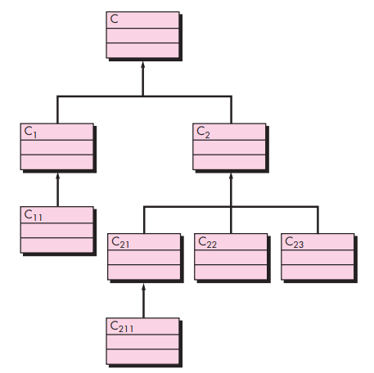
Metrics for Design Model
3. Class Oriented Metrics – The CK Metrics Suite (contd.):
Depth of the inheritance tree (DIT) - This metric is “the maximum length from the node to the root of the tree”. As DIT grows, it is likely that lower-level classes will inherit many methods. This leads to potential difficulties when attempting to predict the behavior of a class. A deep class hierarchy (DIT is large) also leads to greater design complexity.
Figure 4: A class hierarchy

Slide 57
Metrics for Design Model
3. Class Oriented Metrics – The CK Metrics Suite (contd.):
Number of children (NOC) - The subclasses that are immediately subordinate to a class in the class hierarchy are termed its children. Referring to Figure 2, class C2 has three children—subclasses C21, C22, and C23. As the number of children grows, reuse increases, but also, as NOC increases, the amount of testing will also increase.
Figure 5: A class hierarchy

Slide 58
Metrics for Design Model
3. Class Oriented Metrics – The CK Metrics Suite (contd.):
Coupling between object classes (CBO) - CBO is the number of collaborations listed for a class. As CBO increases, it is likely that the reusability of a class will decrease. High values of CBO also complicate modifications and the testing that ensues when modifications are made. In general, the CBO values for each class should be kept as low as is reasonable.
Response for a class (RFC) - The response set of a class is “a set of methods that can potentially be executed in response to a message received by an object of that class.” As RFC increases, the effort required for testing also increases because the test sequence grows. It also follows that, as RFC increases, the overall design complexity of the class increases.

Slide 59
Metrics for Design Model
3. Class Oriented Metrics – The CK Metrics Suite (contd.):
Lack of cohesion in methods (LCOM). Each method within a class C accesses one or more attributes (also called instance variables). LCOM is the number of methods that access one or more of the same attributes. If no methods access the same attributes, then LCOM = 0.
To illustrate the case where LCOM ≠ 0, consider a class with six methods. Four of the methods have one or more attributes in common (i.e., they access common attributes). Therefore, LCOM = 4.
If LCOM is high, methods may be coupled to one another via attributes. This increases the complexity of the class design.
It is desirable to keep cohesion high, that is, keep LCOM low.

Slide 60


Metrics for Design Model
4. Class Oriented Metrics – The MOOD Metrics Suite:
Method Inheritance Factor (MIF) - The degree to which the class architecture of an OO system makes use of inheritance for both methods (operations) and attributes is defined as
where the summation occurs over i = 1 to TC. TC is defined as the total number of classes in the architecture, Ci is a class within the architecture, and
Where,
Ma(Ci) is number of methods that can be invoked in association with Ci
Md(Ci) is number of methods declared in the class Ci
Mi(Ci) is number of methods inherited (and not overridden) in Ci
The value of MIF provides an indication of the impact of inheritance on the OO software.

Slide 61

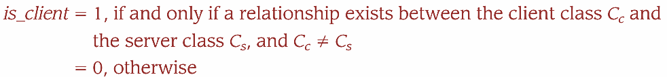
Metrics for Design Model
4. Class Oriented Metrics – The MOOD Metrics Suite (contd.):
Coupling Factor (CF) - Coupling is an indication of the connections between elements of the OO design. The MOOD metrics suite defines coupling in the following way:
where the summations occur over i = 1 to Tc and j = 1 to Tc.
It is reasonable to conclude that as the value for CF increases, the complexity of the OO software will also increase and understandability, maintainability, and the potential for reuse may suffer as a result.

Slide 62
Metrics for Design Model
5. Operation Oriented Metrics
Average operation size (OSavg). Size can be determined by counting the number of lines of code or the number of messages sent by the operation. As the number of messages sent by a single operation increases, it is likely that responsibilities have not been well allocated within a class.
Operation complexity (OC). The complexity of an operation can be computed using any of the complexity metrics proposed for conventional software. Because operations should be limited to a specific responsibility, the designer should strive to keep OC as low as possible.
Average number of parameters per operation (NPavg). The larger the number of operation parameters, the more complex the collaboration between objects. In general, NPavg should be kept as low as possible.

Slide 63
Metrics for Design Model
6. User Interface Design Metrics
Layout appropriateness (LA) is a worthwhile design metric for human/computer interfaces.
A typical GUI uses layout entities—graphic icons, text, menus, windows, and the like—to assist the user in completing tasks.
To accomplish a given task using a GUI, the user must move from one layout entity to the next.
The absolute and relative position of each layout entity, the frequency with which it is used, and the “cost” of the transition from one layout entity to the next all contribute to the appropriateness of the interface.

Slide 64
Metrics for Design Model
7. Component Level Design Metrics
Component-level design metrics for conventional software components focus on internal characteristics of a software component and include measures of the “three Cs”—module cohesion, coupling, and complexity.
Cohesion metrics. The metrics are defined in terms of five concepts and measures:
Data slice. Stated simply, a data slice is a backward walk through a module that looks for data values that affect the module location at which the walk began.
Data tokens. The variables defined for a module can be defined as data tokens
Glue tokens. This set of data tokens lies on one or more data slice.
Superglue tokens. These data tokens are common to every data slice in a module.
Stickiness. The relative stickiness of a glue token is directly proportional to the number of data slices that it binds.

Slide 65
Metrics for Design Model
7. Component Level Design Metrics (contd.)
Coupling metrics. Module coupling provides an indication of the “connectedness” of a module to other modules, global data, and the outside environment.
Complexity metrics. They can be used to predict critical information about reliability and maintainability of software systems from automatic analysis of source code.
Complexity metrics also provide feedback during the software project to help control the design activity.
During testing and maintenance, they provide detailed information about software modules to help pinpoint areas of potential instability.
The most widely used (and debated) complexity metric for computer software is cyclomatic complexity (lower value desirable for being less error prone).

Slide 66
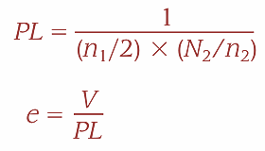

Metrics for Testing
Halstead Metrics Applied to Testing:
Using the definitions for program volume V and program level PL, Halstead effort e can be computed as:
The percentage of overall testing effort to be allocated to a module k can be estimated using the following relationship:
where e(k) is computed for module k and the summation in the denominator is the sum of Halstead effort across all modules of the system.

Slide 67
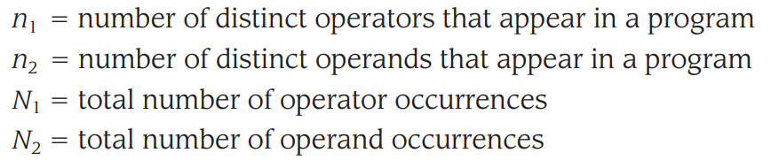
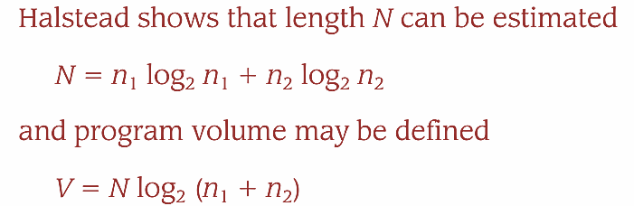

Metrics for Testing
Halstead Metrics Applied to Testing (contd.):
Halstead defines a volume ratio L as the ratio of volume of the most compact form of a program to the volume of the actual program. In actuality, L must always be less than 1.

Slide 68
Metrics for Testing
2. Metrics for Object-Oriented Testing:
Lack of cohesion in methods (LCOM). The higher the value of LCOM, the more states must be tested to ensure that methods do not generate side effects.
Percent public and protected (PAP).
Public attributes are inherited from other classes and therefore are visible to those classes.
Protected attributes are accessible to methods in subclasses.
This metric indicates the percentage of class attributes that are public or protected.
High values for PAP increase the likelihood of side effects among classes because public and protected attributes lead to high potential for coupling.

Slide 69
Metrics for Testing
2. Metrics for Object-Oriented Testing (contd.):
Public access to data members (PAD). This metric indicates the number of classes (or methods) that can access another class’s attributes, a violation of encapsulation. High values for PAD lead to the potential for side effects among classes. Tests must be designed to ensure that such side effects are uncovered.
Number of root classes (NOR). This metric is a count of the distinct class hierarchies that are described in the design model. Test suites for each root class and the corresponding class hierarchy must be developed. As NOR increases, testing effort also increases.

Slide 70
Metrics for Testing
2. Metrics for Object-Oriented Testing (contd.):
Fan-in (FIN). When used in the OO context, fan-in in the inheritance hierarchy is an indication of multiple inheritance. FIN > 1 indicates that a class inherits its attributes and operations from more than one root class. FIN > 1 should be avoided when possible.
Depth of the inheritance tree (DIT). This metric is “the maximum length from the node to the root of the tree”. As DIT grows, it is likely that lower-level classes will inherit many methods
Number of children (NOC). The subclasses that are immediately subordinate to a class in the class hierarchy are termed its children. As the number of children grows, reuse increases, but also, as NOC increases, the amount of testing will also increase.

Slide 71
Metrics for Testing
2. Metrics for Object-Oriented Testing (contd.):
Fan-in (FIN). When used in the OO context, fan-in in the inheritance hierarchy is an indication of multiple inheritance. FIN > 1 indicates that a class inherits its attributes and operations from more than one root class. FIN > 1 should be avoided when possible.
Depth of the inheritance tree (DIT). This metric is “the maximum length from the node to the root of the tree”. As DIT grows, it is likely that lower-level classes will inherit many methods
Number of children (NOC). The subclasses that are immediately subordinate to a class in the class hierarchy are termed its children. As the number of children grows, reuse increases, but also, as NOC increases, the amount of testing will also increase.

Slide 72
Practice Questions
1. What are the four P’s of the management spectrum in software engineering?
a) Planning, People, Process, Product b) People, Process, Product, Project c) People, Planning, Performance, Process d) Project, Process, Productivity, People
Answer: b) People, Process, Product, Project
2. What is the main goal of software metrics?
a) To make programming languages easier to learn b) To improve software quality and process efficiency c) To increase hardware speed d) To reduce software costs only
Answer: b) To improve software qual

Slide 73
Practice Questions
3. What does DRE (Defect Removal Efficiency) measure?
a) The number of users b) The speed of the software c) The ability to remove defects before delivery d) The cost of software development
Answer: c) The ability to remove defects before delivery
4. What is another name for "Problem Decomposition"?
a) Partitioning b) Integration c) Debugging d) Testing
Answer: a) Partitioning

Slide 74
THANKS

